Slide 1

2026 BENEFITS
OPEN ENROLLMENT

Slide 2
INTRODUCTION
Kate Eldridge
Senior Benefits Administrator
Courtney Rotchford
Wellness Manager
Susan Sinclair
Retirement Plan Manager

Slide 3
QUESTIONS???
Type your questions into the zoom Q&A and a member of the team will answer.
Personal questions should be sent to Human.Resources.Benefits@dartmouth.edu

Slide 4
WHAT IS OPEN ENROLLMENT?
Open Enrollment is your annual opportunity to make changes to your health, welfare and wellness benefits for the upcoming calendar year.
dartgo.org/benefits-oe

Slide 5

WHEN IS OPEN ENROLLMENT?
Monday, October 27, 2025 (8:00 am)
through
Monday, November 10, 2025 (11:59 pm)
Changes take effect on
January 1, 2026
dartgo.org/benefits-oe

Slide 6
WHAT HAPPENS IF I DO NOTHING?
Take action if you would like these
benefits in 2026
Medical/Pharmacy
  if covering a spouse
Employee Contributions to a
  Health Care FSA (HCFSA)
  Limited Purpose FSA (LPFSA)
  Health Savings Account (HSA)
  Dependent Care FSA (DCFSA)
Dartmouth contribution to the Child-Care Subsidy (if eligible)
Wellness Options
  Lewinstein Athletic Center (acknowledge a waiver)
Plan and coverage level will carry forward into 2026 with adjusted rates
Medical/Pharmacy
  No spousal coverage
Dental
VSP Vision Benefit
Dartmouth Contributions to HCFSA, HRA and HSA
Basic & Supplemental Life Insurance
Dependent Life Insurance
STD, LTD and AD&D
Voluntary Benefits
Wellness Options
  Lifestyle Spending Account (LSA)
dartgo.org/benefits-oe

Slide 7

Review the 2026 Open Enrollment materials
Sign up for 1:1 enrollment assistance
Sign up for a 1:1 consultation
Watch the educational videos
Open Enrollment Newsletter
2026 Benefits Guide
Benefit Cost Estimator tool
Review individual webpages
Ask Emma Decision Support
dartgo.org/benefits-oe

Slide 8
FLEXONLINE ENROLLMENT ASSISTANCE
If you need assistance with FlexOnline, the Benefits Team is here to help!
October 27 – November 7
Virtually chat with us via Zoom
We can call you and help make
changes over the phone
We can meet in person at 7 Lebanon Street (2nd Floor)
Sign up for a 30-minute session at dartgo.org/benefits-oe

Slide 9

ENROLLMENT CONSULTATION
Do you have a complex benefits situation and need to talk
with a member of the benefits team about it prior to enrolling?
October 27 – November 7
Virtually chat with us over Zoom
We can call you and talk over the phone
We can meet in person at 7 Lebanon Street (HR - 2nd Floor)
Sign up for a 30-minute session at dartgo.org/benefits-oe

Slide 10

BENEFIT PLAN COST ESTIMATOR
Find 2026 rates for the following benefits...
Medical plan options
Dental plan options
Supplemental Life Insurance
Long Term Disability
Vision Benefits
Voluntary Benefits
Access the cost estimator at dartgo.org/benefit-cost-estimator

Slide 11

DARTMOUTH BENEFITS OFFICE
2026
Changes

Slide 12
MEDICAL PLAN RATES
2026 Medical Plan Rates
In 2026, medical rates will increase by 12%.
Dartmouth will continue to subsidize ~75% of the cost of the medical plan in aggregate
The medical plan rate is determined by the plan you choose, your FTE, annual salary and tier of coverage in the plan.
  Access the cost estimator tool to determine monthly rates.
dartgo.org/benefits-cost-estimator

Slide 13
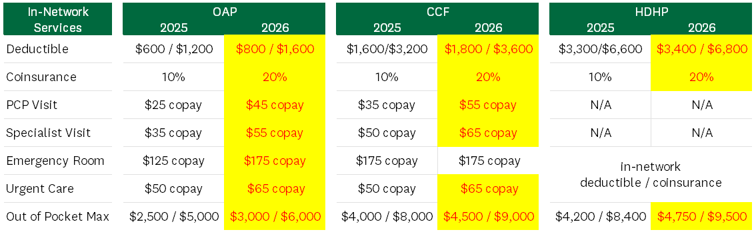
MEDICAL INSURANCE
In-Network Medical Plan Design Changes
JVISA/OAP Plan will maintain the $500/$1,000 annual deductible per Department of State guidelines
dartgo.org/medical

Slide 14
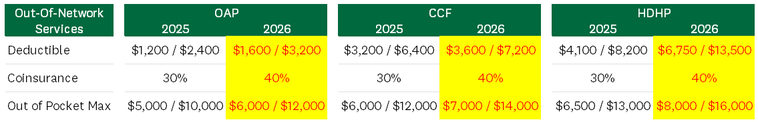
MEDICAL INSURANCE
Out-of-Network Medical Plan Design Changes
Out-of-Network Mental Health Exception Benefit
The coinsurance cost share on the first 12 (lifetime) out-of-network mental health exception visits will increase from 90%/10% to 80%/20%. HDHP with HSA must meet the annual deductible before 12 lifetime visits apply.
dartgo.org/medical

Slide 15
CIGNA’S PATHWELL SPECIALTY PROGRAM
The Pathwell Specialty program will ensure specialty drug injections are delivered by cost-effective, high-quality providers.
Includes a national medical infusion/injectable network
Includes a care management team to guide patients and providers toward Pathwell’s network providers.
Addresses overbilling by directing patients to cost-efficient providers
Includes a design change on the OAP plan for office infusions, from covered
at 100% to deductible/coinsurance
dartgo.org/medical

Slide 16
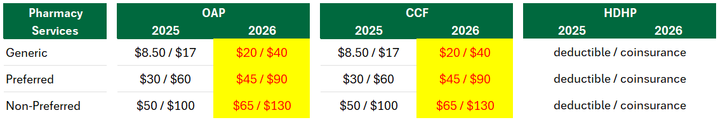
PHARMACY
Retail 30-day and CVS/Mail Order 90-day Pharmacy Changes
Reminder: Get 90-day fills on maintenance medications through CVS Retail stores or through Express Scripts mail order for the cost of a 60-day fill.
dartgo.org/pharmacy

Slide 17

PHARMACY
Implementing Express Scripts Utilization Management
Some medications may now require:
  Prior Authorization – Clinical oversight for higher-cost drugs and specialty medications.
  Step Therapy - Encourages clinically effective front-line medications before trying second line medications.
  Drug Quantity Management - Aligns dispensing quantity and treatment frequency with FDA approved dosage guidelines.
Certain drugs may be replaced with lower-cost alternatives.
Employees impacted by these changes will receive direct communication 1 month prior, with details about their coverage and next steps.
dartgo.org/pharmacy

Slide 18
MEDICAL PLAN SPOUSAL SURCHARGE
Starting January 1, 2026
$100 per month ($50/biweekly) pre-tax* surcharge if they:
  Cover a spouse with access to group medical insurance through their own employer
  Cover a spouse who is retired and has access to a medical plan through their former employer.
Does NOT apply if you and your spouse both work for Dartmouth
Employees must complete a spousal surcharge attestation in FlexOnline if covering a spouse in 2026
  Will be prompted when they enroll in a medical plan
  * post-tax for Research Fellows
dartgo.org/spousal-surcharge

Slide 19
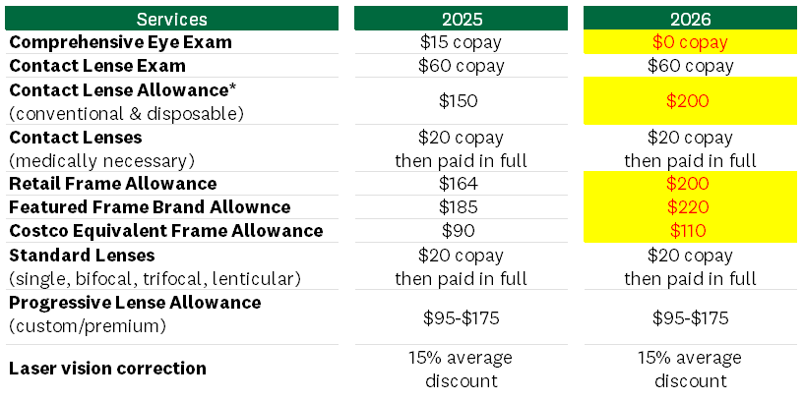
VSP VISION COVERAGE
* Enhancements shown are when using VSP in-network providers
dartgo.org/vision

Slide 20
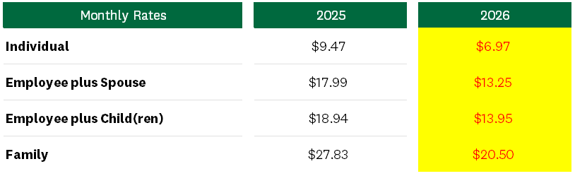
VSP VISION RATES
26.3% decrease in vision rates for 2026
dartgo.org/vision

Slide 21
DARTMOUTH BENEFITS OFFICE
What isn’t changing
In 2026

Slide 22
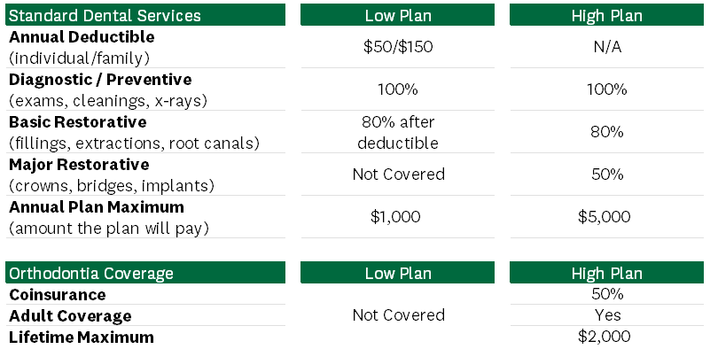
DENTAL INSURANCE
dartgo.org/dental

Slide 23
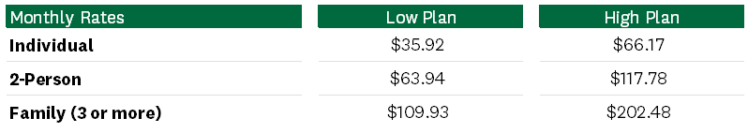
DENTAL RATES
dartgo.org/dental

Slide 24
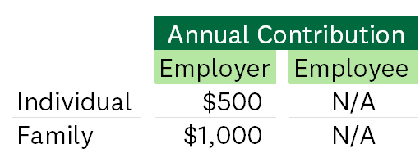
HEALTH “REIMBURSEMENT” ACCOUNT (HRA)
Managed by Cigna Health
Comes automatically with CCF and HDHP w/ HRA medical plans
Contributions are available to use on 1/1/26
An HRA is an employer contribution. Employees cannot contribute to this plan
Cigna automatically “reimburses” your provider for deductible and coinsurance related services. No action required by you.
Unspent HRA balances will carry over into 2026,
if you remain in a medical plan that comes with
an HRA account.
dartgo.org/hra

Slide 25
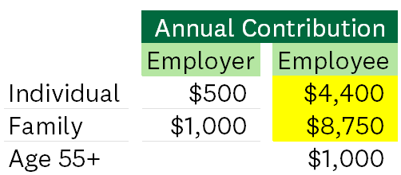
HEALTH “SAVINGS” ACCOUNT (HSA)
Managed by Fidelity
You may contribute when electing HDHP w/ HSA medical plan
Participation in this benefit requires annual enrollment
Balances always carry over year after year
Check eligibility prior to enrolling
  You are not eligible to contribute if your spouse or
  parent can claim you on their HCFSA
  If turning age 65 and enrolling in Medicare
  stop contributions six months prior to your
  65th birthday
dartgo.org/hsa

Slide 26
HEALTH CARE FLEXIBLE “SPENDING” ACCOUNTS
Managed by Sentinel Benefits
Eligibility for the $250 Dartmouth Contribution in a HCFSA
Biweekly paid OR
Monthly paid and earning $60,000/year or less
AND
Enrolled in the OAP medical plan; OR
Waiving Dartmouth Medical Coverage
dartgo.org/hcfsa

Slide 27
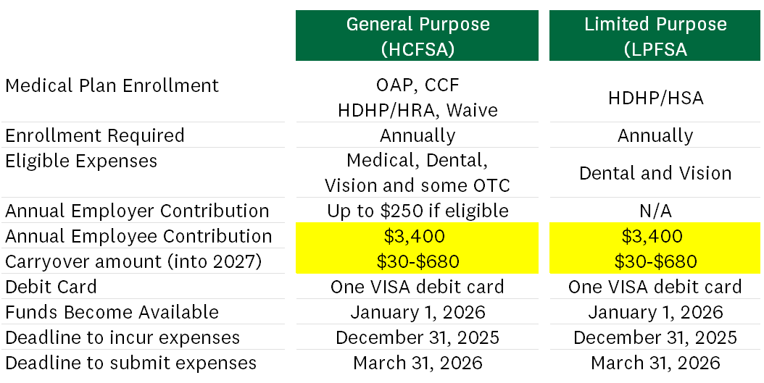
HEALTH CARE FLEXIBLE “SPENDING” ACCOUNTS
NEW- Research Associate B’s are now eligible to contribute
dartgo.org/hcfsa or dartgo.org/lpfsa

Slide 28
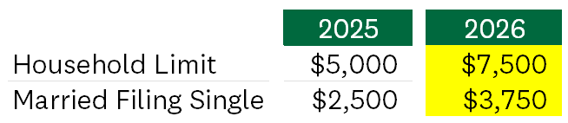
DEPENDENT CARE FLEXIBLE “SPENDING” ACCOUNT (DCFSA)
Managed by Sentinel Benefits
Pre-tax deductions can be used to pay for eligible child and adult day care services including summer day camps and after school programs
Participation in this benefit requires annual enrollment
Use it or lose it benefit
NEW - Increased Limit for 2026
dartgo.org/dcfsa

Slide 29
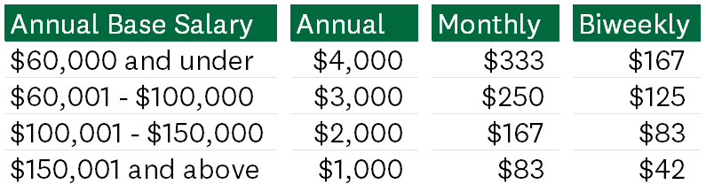
DCFSA WITH CHILDCARE SUBSIDY
Legal parents or guardians of a child aged 0 through 5, may receive a contribution to a DCFSA account, each pay period, up to the child’s sixth birthday
Per the IRS, DCFSA rules and limits will apply
Participation in this benefit requires annual enrollment
There is a limit of one subsidy per family regardless of the number of eligible children
Subsidy amount counts toward DCFSA
limit
Use it or lose it benefit
Annual salary is determined during open enrollment
dartgo.org/child-care-subsidy

Slide 30
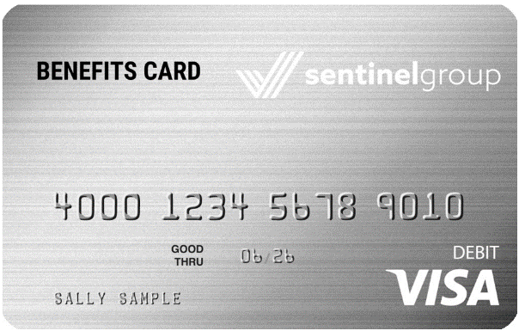
THE FSA DEBIT CARD
Managed by Sentinel Benefits
New enrollees will receive a Sentinel Benefits debit card to help pay expenses at the time of service
Use one VISA debit card for all of Sentinel’s FSA products year after year, until the card expires
dartgo.org/fsa

Slide 31
LIFE INSURANCE
$50,000 basic life option
  For faculty, exempt and non-exempt employees at no cost
  SEIU employees please refer to your union contract.
  Research Associate B’s and Research Fellows pay for this benefit.
Supplemental Life Insurance
  Eligible employees can elect 1x to 8x annual salary to a maximum coverage level of $1.5M
  Increasing life insurance coverage during open enrollment requires Evidence of Insurability (EOI).
Dependent Life Insurance
  $25,000 coverage for spouse and $10,000 coverage per child (no additional cost per child)
  Research Associate B’s and Research Fellows are not eligible for this benefit
dartgo.org/life-insurance

Slide 32
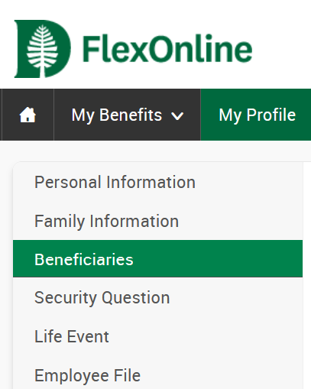
LIFE INSURANCE BENEFICIARIES
You can allocate your life insurance beneficiaries in FlexOnline
at any time during the year.
Use this opportunity to review and make revisions to any of the following life insurance products:
  Basic Life
  Supplemental Life
  Accidental Death & Dismemberment
  Business Travel Accident
Within FlexOnline, click on My Profile
and then Beneficiaries to make changes.
dartgo.org/life-insurance

Slide 33
LONG-TERM DISABILITY
Managed by Lincoln Financial Group
Dartmouth College provides 50% pay replacement at no cost
to employees up to a maximum of $15,000 per month
You may increase existing coverage by 10% during open enrollment to 60% or 70% for an additional cost.
  You may also decrease coverage during open enrollment.
Employees actively receiving LTD benefits are not eligible to buy additional coverage.
dartgo.org/disability

Slide 34
VOLUNTARY BENEFITS
Managed By Cigna
  These are not health
  insurance plans
  They are designed to “compliment” your existing health insurance plan
  Receive lump sum payments for services incurred
  If you are enrolled in a Dartmouth medical plan and experience an eligible claim, Cigna will notify you to submit a voluntary benefit claim
Hospital Indemnity Insurance
(in-patient hospital stays)
Personal Accident Insurance
(cost associated with accidental injury)
Critical Illness/Cancer Insurance
(diagnosis of covered critical illness + a $50
annual health screening incentive)
View and access claims information through the same mycigna.com portal that you use to view your medical claims.
dartgo.org/voluntary

Slide 35
DARTMOUTH BENEFITS OFFICE
Other
Important
Information

Slide 36

ENROLLING IN BENEFITS
Access FlexOnline and enroll in your health and wellness benefit wherever you see this link.
Use your single sign on Dartmouth ID and password to log in.
FlexOnline.Dartmouth.edu

Slide 37
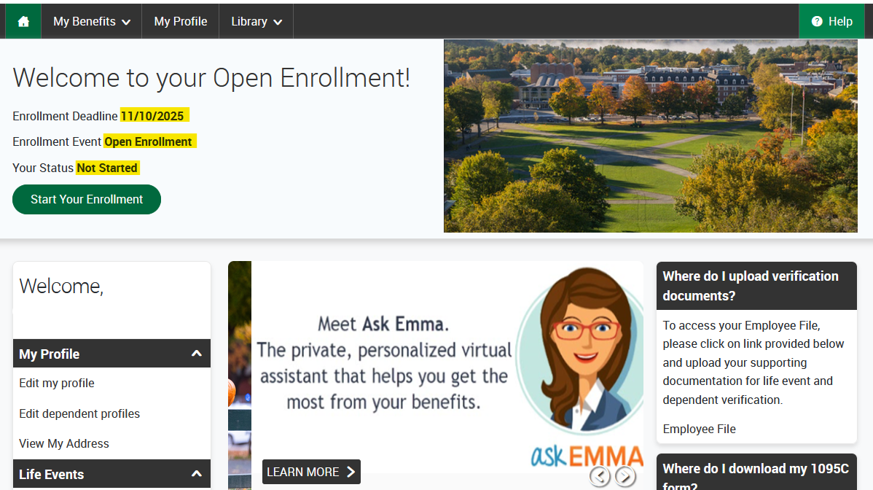
FLEXONLINE ENROLLMENT

Slide 38
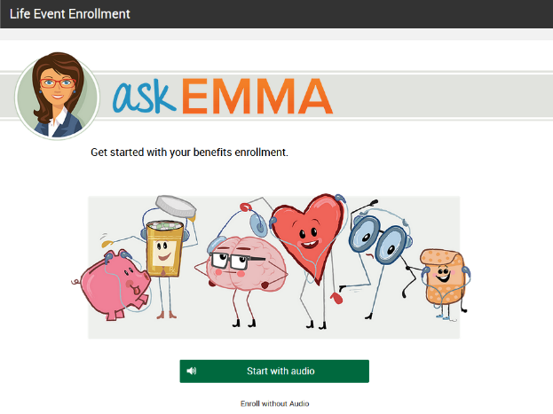
ask EMMA DECISION TOOL
Explains benefits
Answers common questions
Try different scenarios
Provides estimated annual costs
Helps with decision making

Slide 39

DEPENDENT VERIFICATION
Dependent Verification is required the first time you are adding dependents to a medical, dental or vision plan. You will receive an email reminder to upload in FlexOnline, once you complete your enrollment.
  Spouse – Marriage Certificate
  Children – Birth Certificates
Review Process
  Please allow 3-5 days for the review and approval of verification documents.
  Watch your Dartmouth email carefully for approvals or denials
  of your documents
For more information go to dartgo.org/dependent_verification

Slide 40
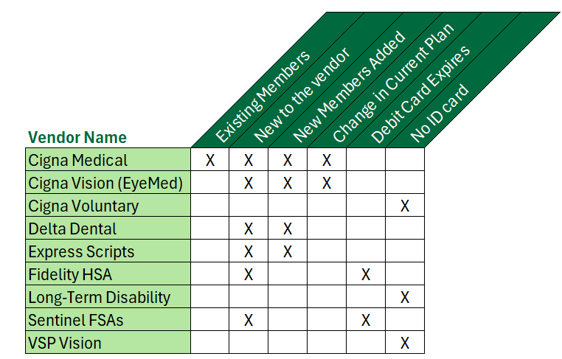
ID CARDS
Most vendors offer digital ID cards through their
phone app
ID cards will begin
Arriving in Mid-
December

Slide 41
FINAL REMINDERS
Open Enrollment is October 27th – November 10th
Review the Open Enrollment resources at dartgo.org/benefits-oe
Be sure to COMPLETE your enrollment and UPLOAD verification documentation in FlexOnline
ID cards, will be mailed mid to late December.
Human.Resources.Benefits@dartmouth.edu 603-646-3588

Slide 42
Wellness

Slide 43

WELLNESS BENEFIT CHANGES
The Pulse Program Wellness Benefit will be discontinued on December 31, 2025.
Current Pulse participants, please make note of the following:
These two Wellness Benefits will continue for 2026, with no changes:
Option 1: Lifestyle Spending Account (LSA)
Option 2: Dartmouth Fitness Membership at Lewinstein Athletic Center
Action | Deadline
Engage in the Pulse Program to earn points and rewards | Now through December 31, 2025
Select a wellness benefit option in FlexOnline during Open Enrollment. You have a choice of one of these two benefits: Lifestyle Spending Account (default) Dartmouth Fitness Membership at Lewinstein Athletic Center | October 27 – November 10, 2025
Pulse Program points stop accumulating | December 31, 2025
Redeem all earned rewards | January 31, 2026
dartgo.org/wellnessbenefits

Slide 44
WELLNESS BENEFIT OPTIONS
Option 1: Lifestyle Spending Account (LSA)
  Available to Employees and Enrolled Spouses (shared benefit)
  The LSA is a flexible benefit in which you receive a reimbursement of up to $250 each calendar year for a range of well-being expenses—such as gym memberships, home fitness equipment, farm shares, hobby classes, nutrition programs, and more
  Simple (and quick!) online reimbursement process through Sentinel, our FSA administrator.
  Important: If you have the LSA as your 2025 election, you will automatically be defaulted to the LSA for 2026, unless you elect a different wellness benefit during the Open Enrollment period.
  Important: The deadline to submit 2025 LSA expenses is January 15, 2026. This is a “use it or lose it” benefit.
dartgo.org/wellnessbenefits

Slide 45
WELLNESS BENEFIT OPTIONS
Option 2: Dartmouth Fitness Membership at Lewinstein Athletic Center
Receive a free Dartmouth Fitness membership at Lewinstein Athletic Center (formerly Alumni Gym) from January 1, 2026 – December 31, 2026 (value $450)
Available to Employees only
Important: If you have this benefit as your 2025 election, and you wish to continue for 2026, you must re-elect this benefit and acknowledge the gym waiver in FlexOnline during Open Enrollment each year, otherwise you will default to the LSA for your 2026 wellness benefit.
dartgo.org/wellnessbenefits

Slide 46
ONE MEDICAL AT DARTMOUTH
  A primary care practice managed by One Medical, specifically for employees and your adult family members, 18+, enrolled on a Dartmouth-sponsored medical plan.
  NEW for 2026: $15 copay for non-preventive visits; $0 copay will continue for preventive care services such as annual physicals, wellness screenings, and on-demand care virtual care (Video Chat, Discuss Common Conditions, Messaging, Rx Renewals)
  Conveniently located in Hanover at 7 Allen Street with free parking
  Long, non-rushed appointments that start on time
  Drop-in onsite lab services
  A care team dedicated to your well-being, with in-office appointments and 24/7 access to the virtual medical team
  App-based access for scheduling appointments, prescription requests, care team messaging, on-demand care, and more
  One Medical is accepting new patients!
  Please note: due to IRS regulations you cannot be contributing to or receiving contributions to a Health Savings Account and be a patient at the practice (if you are enrolled in the HDHP with HSA you are not eligible for One Medical at Dartmouth).
dartgo.org/omd

Slide 47
OTHER WELLNESS UPDATES
New Support For Your Well-being: Behavioral Health Coaching
  Benefits-eligible employees can meet in-person or virtually with the on-campus Behavioral Health Coach offering confidential, 1:1 support tailored to your health goals. Get guidance for managing stress, weight, diabetes, high blood pressure, and more, available at no cost.
  Learn more at dartgo.org/behavioralhealthcoach
Headspace Update
  Headspace gives employees, and now up to five loved ones, premium access to its science-backed app, at no cost.
  1000+ hours of content designed to help you stress less, focus more, sleep better, exercise mindfully, and more!
  Learn more at dartgo.org/headspaceinfo
dartmouth.edu/wellness

Slide 48
FACULTY/EMPLOYEE ASSISTANCE (F/EAP) PROGRAM
  In partnership with ComPsych GuidanceResources, the F/EAP provides you, and your household members, with confidential support, resources and information for personal and work-life issues.
  These services are provided at no cost
  Resources available include:
      Confidential Counseling (up to 8 sessions per issue per year) – meet with the on-campus Counselor, Chris Henderson, MA, LCMHC, or meet with a counselor local to you, or virtually.
      Legal Guidance – divorce, adoption, family law, wills, trusts, estate planning
      Financial Resources – budgeting, debt management, tax and real estate, financing for college
      Work & Lifestyle Support – child/elder/pet care, home repair, buying a car, planning a vacation, etc.
      NEW! Huddles – interactive online groups on a variety of well-being topics – mindfulness, nutrition, menopause, back pain
  Available 24/7
      Call: 844.216.8308
      Online: www.guidanceresources.com (click on register and enter ID: Dartmouth)
      App: GuidanceNow®
dartgo.org/eap

Slide 49
CIGNA WELLBEING RESOURCES
  For employees and dependents enrolled in a medical plan through Dartmouth:
  Virtual Behavioral Health Programs:
    Access a variety of virtual services including options for children, teens, and adults. Support is available through text, phone, and video, and cover a wide range of needs – anxiety, depression, stress, relationship/family challenges, sleep, eating disorders, parenting, etc.
    Mycigna.com > Find Care & Costs > Counseling
  Omada Pre-Diabetes Program:
    A digital lifestyle change program that can help you lose weight, feel fantastic, and develop long-term healthy habits for those who are at risk for type 2 diabetes or heart disease (free!)
    Take the 1-minute assessment at omadahealth.com/dartmouth
mycigna.com

Slide 50
ADDITIONAL RESOURCES
Webinars
  A variety of webinars are offered monthly on well-being topics such as mindfulness, healthy eating, sleep, managing finances, parenting, and more!
Mindfulness Groups
  Monday Morning Meditation (8am in Rollins Chapel)
  Wednesday Virtual Mindfulness Practice Group (NEW TIME! 12:05pm via Zoom)
NEW! Thursday Steppers
  Join colleagues for a weekly campus walk on Thursdays (12:15 – 12:45 PM; meet at the flagpoles on the Green)
Stay in the Know:
  Wellness at Dartmouth website: dartmouth.edu/wellness
  Monthly Wellness at Dartmouth newsletter: dartgo.org/subscribe
  Be on the lookout: Throughout the year, our partners may reach out to you with tips, tools, and reminders to help you make the most of your benefits.
dartmouth.edu/wellness

Slide 51
Retirement

Slide 52
RETIREMENT PLANS
DARTMOUTH contributes to your 401(a) Plan Account
YOUR voluntary contributions to the SRA
Age | Percentage of Base Salary
21-29 | 3%
30-34 | 5%
35-39 | 7%
>=40 | 9%
Many ways to save for retirement:
Pre-tax contributions
Roth post-tax contributions
Save a percentage of your pay
Save a fixed dollar amount
After 3 years of service at Dartmouth, you will fully own (100% vested) Dartmouth’s contributions
You are always 100% vested in your SRA contributions (you fully own them)
Human.Resources.Benefits@dartmouth.edu 603-646-3588

Slide 53
NEW FOR 2026
CHANGES TO THE SRA
Starting January 1, 2026, new limits and rules apply to catch-up contributions.
Catch-up contributions (“catch-up”) allow individuals nearing retirement to save more in their SRA. Pre-tax and/or Roth post-tax SRA contributions above the IRS Standard Limit are classified as a catch-up. These are available only to SRA participants age 50 or older during the calendar year.
2025 IRS Contribution Limits Standard Limit (Under age 50) = $23,500 Age 50 or older = $23,500 + $7,500 catch-up = $31,000
New for 2026: Super Catch-up Higher catch-up limit for participants age 60-63 | New for 2026: Catch-up must be Roth for certain participants
SRA participants age 60-63 during the calendar year will have a higher catch-up limit. The IRS will announce the 2026 limit later this year. We expect this limit to be at least $11,250 based on the 2025 limit. | An amount equal to your catch-up contribution (based on your age) must be designated as Roth post-tax for SRA participants that earned $145,000 or more in FICA wages in the prior year. The IRS determines the $145,000 threshold - it may change annually.
Human.Resources.Benefits@dartmouth.edu 603-646-3588

Slide 54
NEW FOR 2026
SRA SUPER CATCH-UP CONTRIBUTION
Eligibility for the Super Catch-up
  SRA participants that are age 60, 61, 62, or 63 during the calendar year
  Example: If you turn age 60 on December 28, 2026, you are eligible for the Super Catch-up on January 1, 2026
2026 maximum Super Catch-up contribution
  The IRS has not announced this limit – we expect the announcement in November
  It is expected that it will be at least as high as the 2025 limit: $11,250
  When announced by the IRS, the new limits will be posted in the VOX Daily email and on dartgo.org/retirement
Participants age 64 and older
  The age 50 or older catch-up limit will apply to participants once Super Catch-up eligibility ends
Update your SRA contribution election at NetBenefits.com
  The steps to update your SRA paycheck deduction amounts remain the same
Human.Resources.Benefits@dartmouth.edu 603-646-3588

Slide 55
NEW FOR 2026
CATCH-UP AS ROTH FOR CERTAIN PARTICIPANTS
Late January/Early February 2026
Each Payroll
Benefits will email participants required to have catch-up (or Super Catch-up) as Roth post-tax after Form W-2s are issued for 2025
Dartmouth will track pre-tax and/or Roth post-tax SRA contributions to monitor limits and identify catch-up (or Super Catch-up) contributions
A Roth post-tax designation will be automatically applied to your catch-up (or Super Catch-up) contributions – no action is required – if the rule applies
The contribution will appear in your SRA account(s) and on your pay slip as Roth post-tax
Catch-up contribution rules were updated as part of the Consolidated Appropriations Act of 2023 enacted December 2022 – also known as “SECURE 2.0”
Certain Participants
SRA participants eligible for catch-up (or Super Catch-up) contributions and who earned FICA Wages of $145,000 or more in 2025 are now required to have an amount equal to the catch-up (or Super Catch-up) contribution designated as Roth post-tax
FICA Wages
Box 3 on your Form W-2, used to calculate your contribution to Social Security and Medicare withholdings
Visit dartgo.org/ess and click “Employee Self-Service” to find your Form W-2
You are not required to change your
SRA contribution election if this applies to you
Human.Resources.Benefits@dartmouth.edu 603-646-3588

Slide 56
MANAGING YOUR RETIREMENT ACCOUNTS
You can change your SRA contributions, investment provider, or fund selection at any time during the year
  2026 IRS Contribution Limits for the SRA will be released later this year
  Check back to dartgo.org/ retirement for updates
Enroll in the SRA
  Use www.netbenefits.com/dartmouth to enroll or change your SRA savings elections
To Select or Change your Investment Provider
  Use www.netbenefits.com/dartmouth to choose whether Fidelity, TIAA, or both will receive your contributions
Change or Update your Fund Selection
  Change or update your fund selection at the provider (Fidelity, TIAA, or both) for each plan that receives your contributions
Choose or Update your Beneficiary
  A beneficiary(s) must be selected for each plan at each provider
  For both Monthly and Bi-Weekly paid employees you must update your
  SRA elections by
  December 23, 2025
  for changes you want to make to your first contributions in January
Human.Resources.Benefits@dartmouth.edu 603-646-3588

Slide 57


RESOURCES TO HELP YOU
PLAN FOR RETIREMENT
Individual Counseling Sessions
Available on-campus, by phone or video conference
Spouses/partners welcome to join
To schedule a session:
Fidelity – http://getguidance.fidelity.com or call 800-642-7131
TIAA – http://www.tiaa.org/schedulenow or call 800-732-8353
Monthly Webinars
Fidelity and/or TIAA offer general webinars or sessions specific to Dartmouth every month
The sessions (including registration information) are communicated in the VOX as well as in the Wellness at Dartmouth Newsletter
dartgo.org/retirement-counseling
Human.Resources.Benefits@dartmouth.edu 603-646-3588

Slide 58
HELPFUL RESOURCES
  Fidelity Investments
  (800) 343-0860
  www.netbenefits.com/dartmouth
  dartgo.org/retirement
  Fee disclosures
  Summary Plan Descriptions
  User Guide
  IRS Contribution Limits
  TIAA
  (800) 842-2252
  www.tiaa.org/dartmouth
Human.Resources.Benefits@dartmouth.edu 603-646-3588

Slide 59
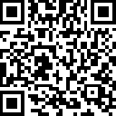
Thank you!
Dartgo.org/benefits-oe

